Slide 1
Data Science Capstone Project
Local Governments Survey (ARISE + CivicPulse Harmonization)
Course Number:CS896 Team #7- Anudeepthi Chirumamilla- Y828R524 Rupali Avhad - d798z925 Teja Sree Mukkapati-Q389W584

Slide 2
This Week Progress Update
Cleaned and standardized both datasets to make them comparable.
Created 18 common variables to align ARISE and CivicPulse data.
Combined both datasets into one final harmonized dataset.
Checked data quality by validating shapes, columns, and missing values.
Analyzed key trends using summary statistics and averages.
Compared results between datasets to identify differences.
Created visualizations like bar charts, histograms, and boxplots to understand patterns better.

Slide 3
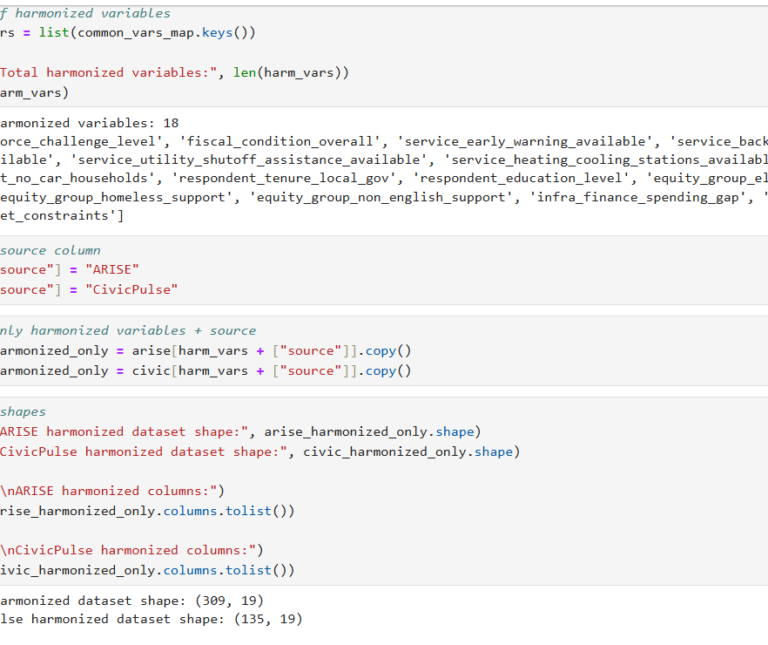
Harmonizing and Preparing the Dataset
Identified 18 common variables to make both datasets comparable.
Added a source column to clearly separate ARISE and CivicPulse data.
Kept only the matching variables to create clean, consistent datasets.
Checked the dataset structure to make sure everything aligned correctly.

Slide 4
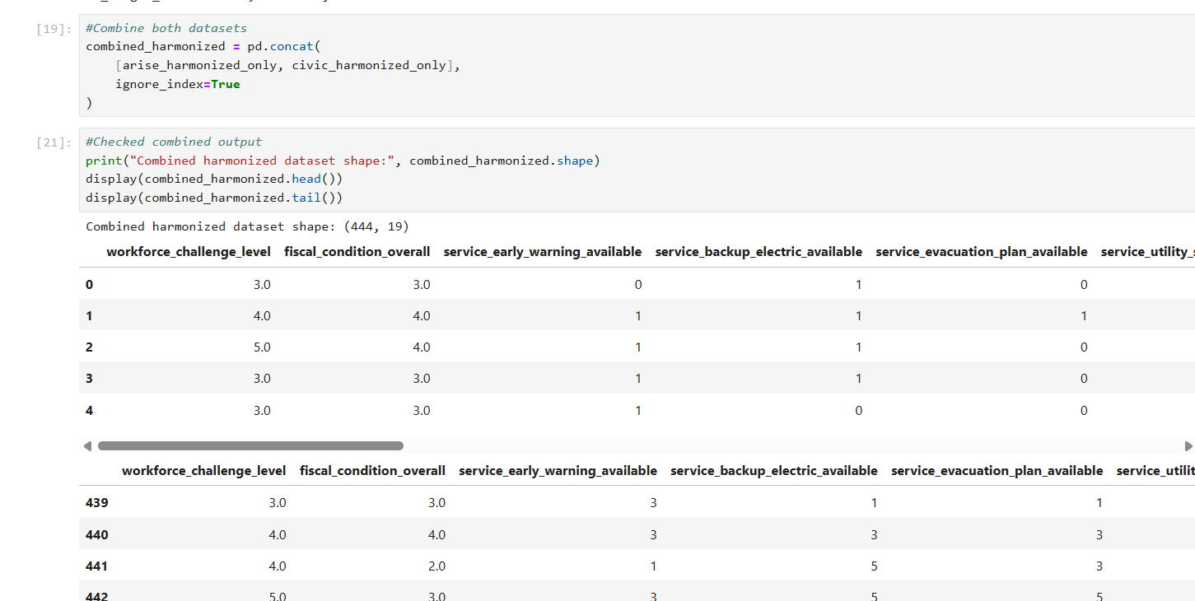
Combining and Validating the Final Dataset
Merged both harmonized datasets into one final dataset.
The combined dataset has 444 records and 19 columns.
Checked the data using head and tail to make sure it looks correct.
This final dataset is now ready for analysis.

Slide 5
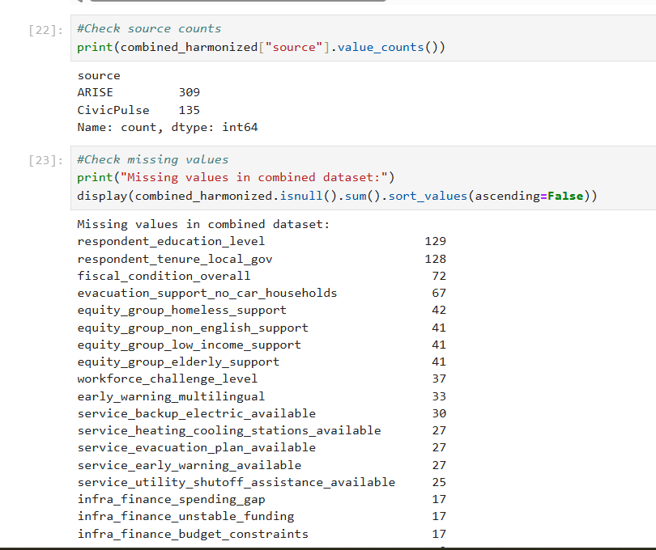
Validating Data and Checking Missing Values
Checked how many records records came from each dataset to confirm the merge worked correctly.
The combined data includes 309 ARISE and 135 CivicPulse records.
Analyzed missing values to understand data quality issues.
Found that some variables like education and tenure have higher missing data.

Slide 6
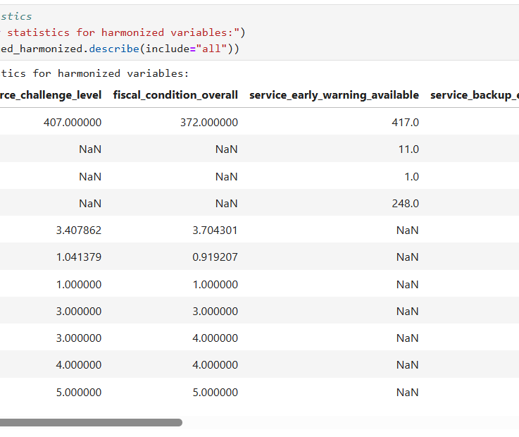
Summary Statistics of Harmonized Data
Generated summary statistics to understand the overall data distribution.
Key variables like workforce challenge and fiscal condition show average values around 3–4.
Most responses fall between mid to high levels, indicating moderate to high challenges.
This step helped me quickly understand trends and data spread before deeper analysis.

Slide 7
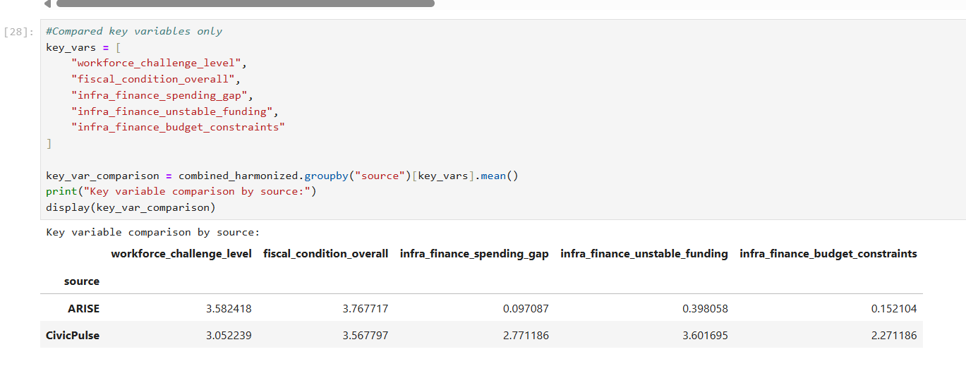
Comparison of Key Variables Between ARISE and CivicPulse
Compared important variables across both datasets to see how they differ.
ARISE shows slightly higher workforce challenges and fiscal condition scores.
CivicPulse reports much higher values for infrastructure funding issues.
This comparison helps highlight real differences in challenges reported by both sources.

Slide 8
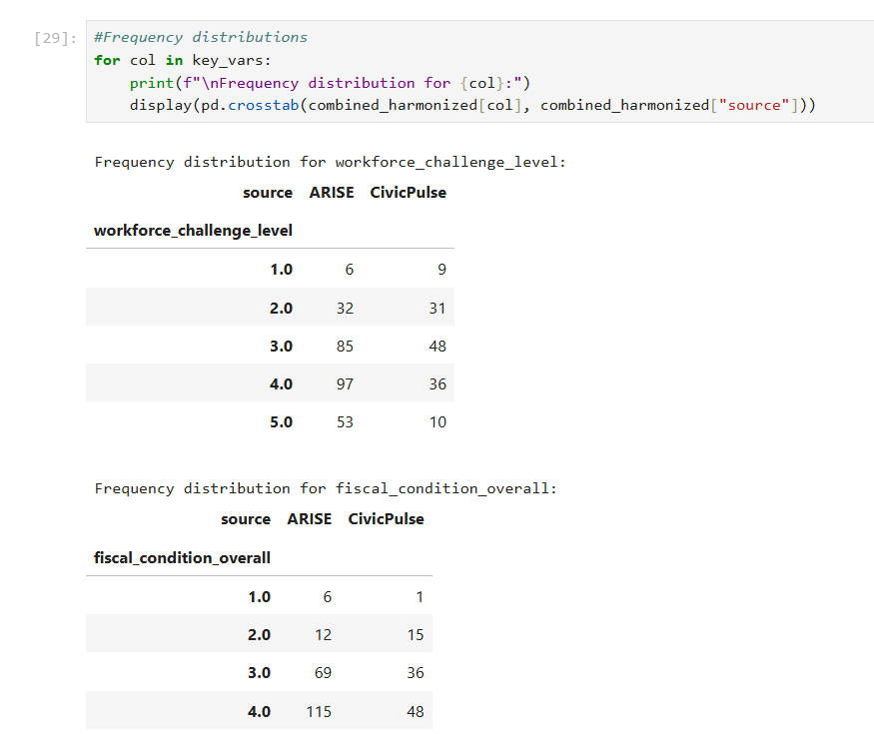
Frequency Distribution of Key Variables by Dataset
Analyzed how responses are distributed across different levels for each dataset.
Most responses in ARISE are concentrated in higher levels (3, 4, and 5).
CivicPulse shows fewer high-level responses compared to ARISE.
This helps understand how response patterns differ between the two datasets.

Slide 9
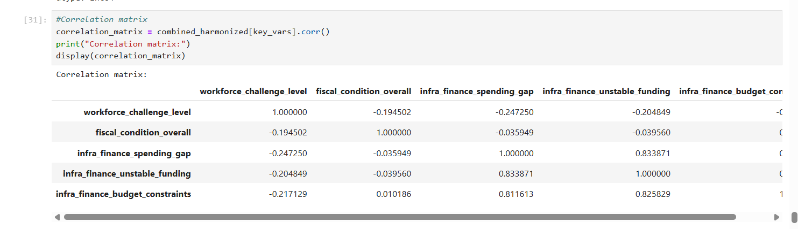
Correlation Analysis of Key Variables
Analyzed how different variables are related to each other using a correlation matrix.
Infrastructure-related variables (spending gap, unstable funding, budget constraints) show strong positive relationships.
Workforce challenge and fiscal condition have weaker or slightly negative relationships with others.
This helps identify which factors are connected and may impact each other.

Slide 10
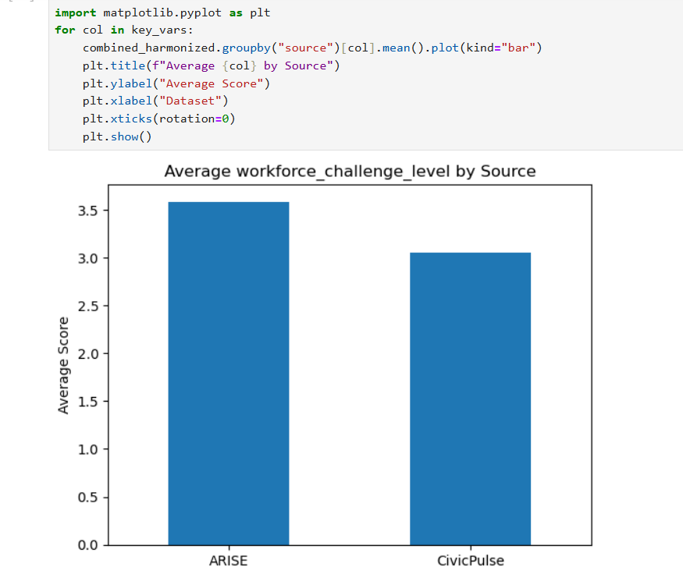
Example: Average Workforce Challenge Level by Dataset
Compared the average workforce challenge levels between ARISE and CivicPulse.
ARISE shows a slightly higher average, indicating more workforce-related challenges.
CivicPulse has a lower average, suggesting comparatively fewer challenges reported.
This helps quickly visualize and compare differences between the two datasets.

Slide 11
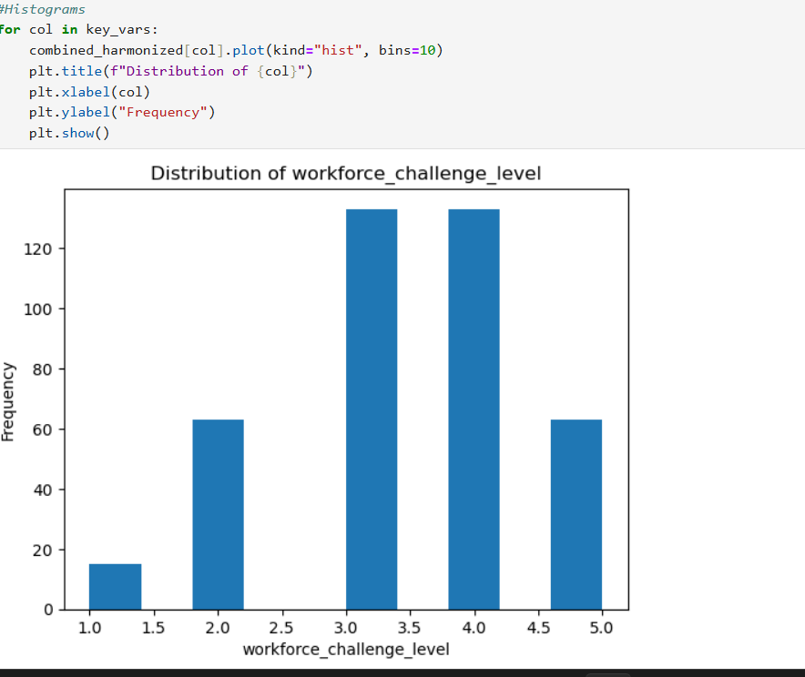
Example: Distribution of Workforce Challenge Levels
visualized how workforce challenge responses are spread across all levels.
Most responses are concentrated around levels 3 and 4, showing moderate to high challenges.
Very few responses fall in the lowest level, indicating challenges are commonly experienced.
This helps understand the overall pattern and intensity of workforce issues in the dataset.

Slide 12
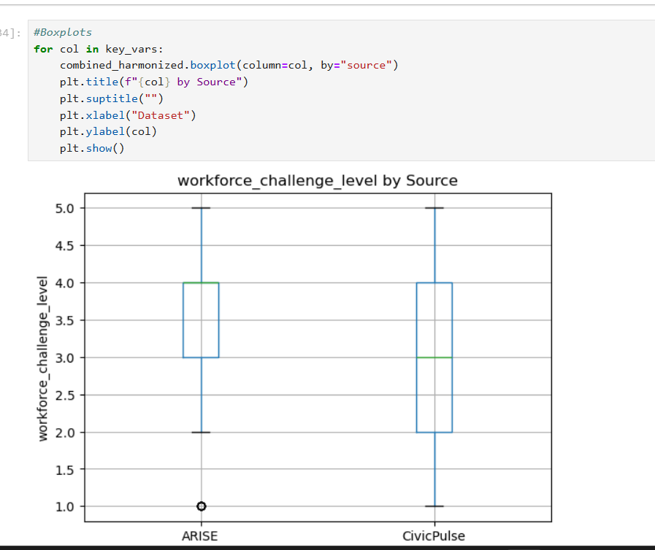
Example: Workforce Challenge Levels Comparison (Boxplot)
Used a boxplot to compare how workforce challenges vary across both datasets.
ARISE has a slightly higher median, meaning overall higher reported challenges.
CivicPulse shows a wider spread, indicating more variation in responses.
This helps understand both the average level and how consistent the responses are.

Slide 13
Next Week Goal
Analysis we have to do for next week –
Cross-tabulation
Percentage-based analysis
Basic regression
Final insights/ Conclusions
Interpretation for results

